Slide 1


SOCIAL
BUZZ

Slide 2


Today's agenda
Project Recap
Problem
The Analytics Team
Process
Insights
Summary

Slide 3

“Social Buzz” is a rapidly expanding unicorn in the technology space that needs to quickly adjust to its global reach.
Accenture has started to working on the following activities during a three-month POC:
An examination of Social Buzz’s use of big data.
Strategies for a prosperous initial public offering(IPO)
An examination to determine the top 5 content categories on Social Buzz
Project Recap

Slide 4

Problem
100k+ daily posts -> 3.6M annual posts
Difficult to handle such big data
Identify Top 5 categories with the largest aggregate popularity

Slide 5



Andrew Fleming
Chief Technology Architect
The Analytics team
Marcus Rompton
Senior Principal Analyst
Meenakshi Poorani Karunakaran
Data Analyst

Slide 6
Process
1
Understanding Data
2
Data Cleaning
3
Data Modelling
4
Data Analysis
5
Uncover Insights

Slide 7

Insights
Unique
Categories
Most popular Category
“Animals”
Month with Most Posts
16
Reactions
1897
MAY

Slide 8
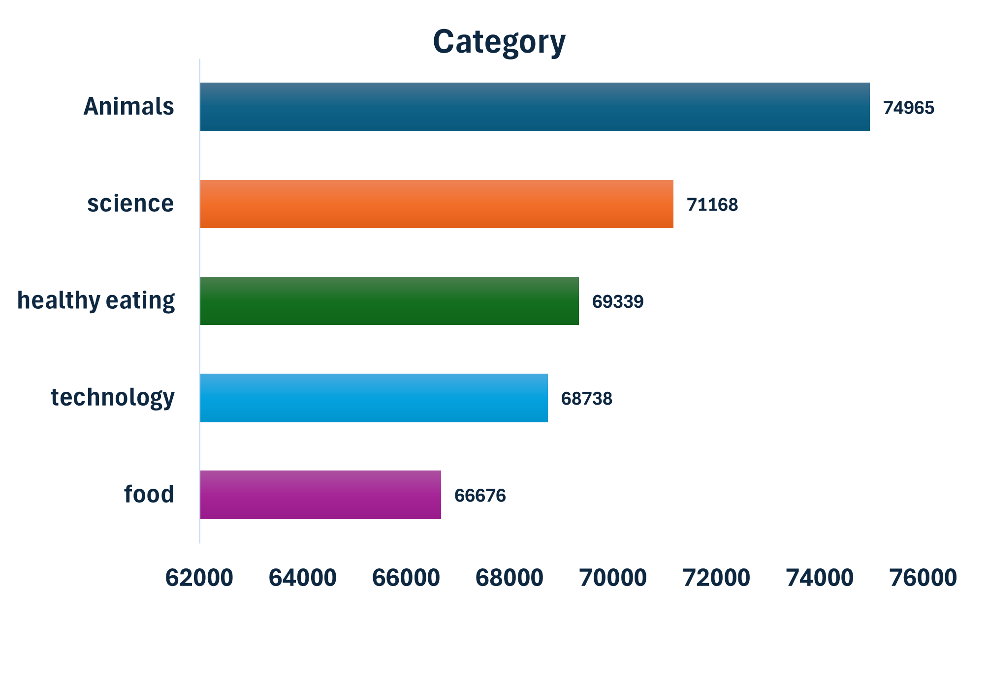
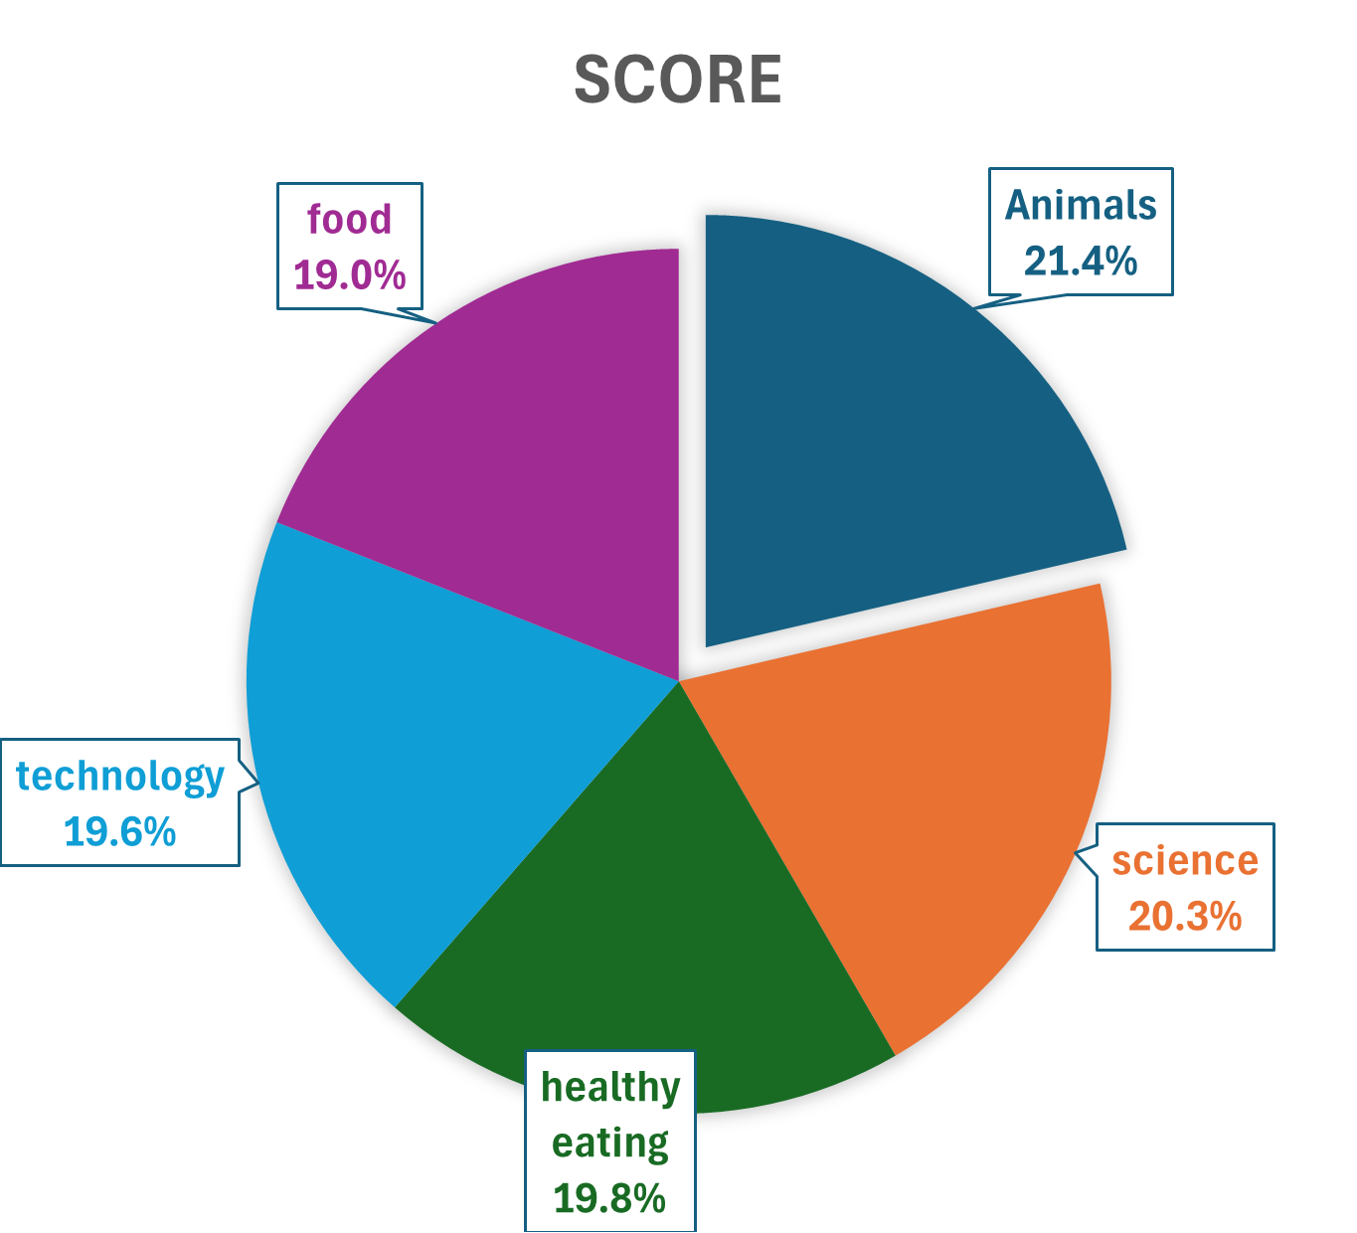
Top 5 Categories By Aggregate Popularity Score
Popularity percentage from Top 5 Categories

Slide 9
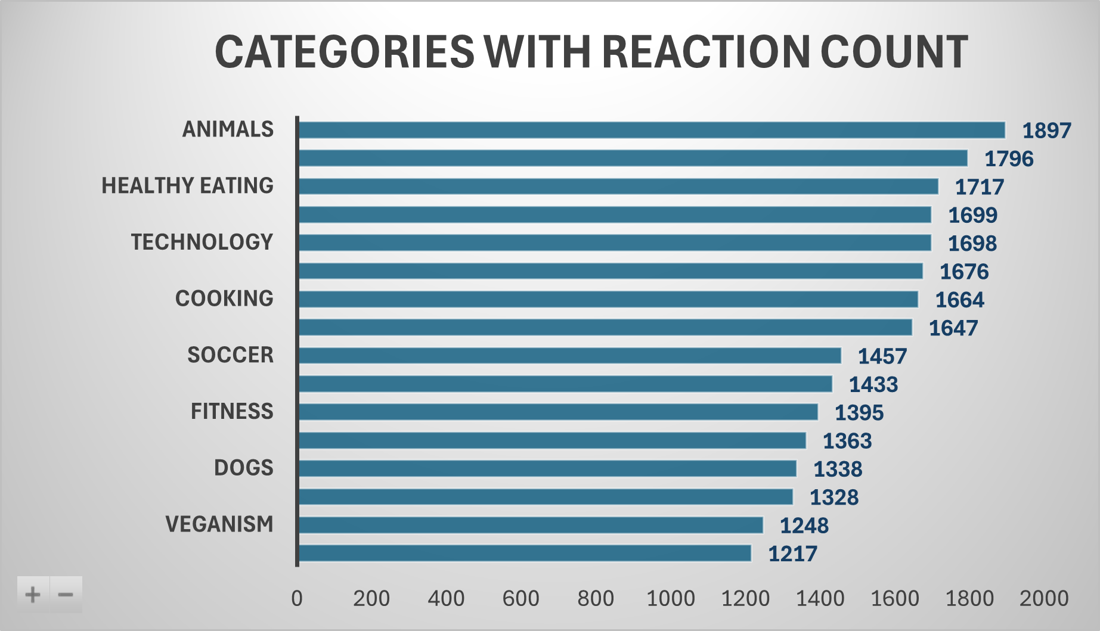
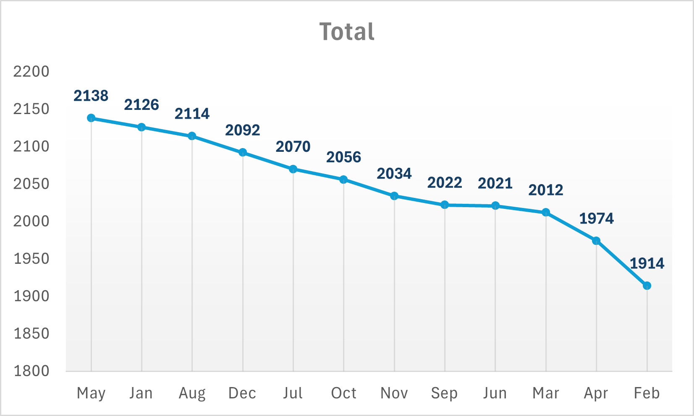

Slide 10

ANALYSIS:
Animals and Science are the most popular categories of content, that shows people enjoy “real-life” and “factual” content the most.
INSIGHTS:
“Animals” has garnered most number of reactions among the categories.In 2020, August saw most number of posts and in 2021, ‘MAY’ has seen most posts, thus far.
NEXT STEPS:
While this ad hoc analysis is insightful, it is important and timely to take this further for real time understanding of the business. We can work with you and show you how this can achieved.
Summary

Slide 11
Thank you!
ANY QUESTIONS?

